Slide 1

Presentation
Angad Bhende
Cs25068

Slide 2
Problem statement:
Library Book Catalog: Create a searchable catalog for "City Central Library." Display books in a table with columns for title, Author , ISBN, and Avaibility (use color coding). Include a search/filter box

Slide 3
Github link: CSS:-
https://github.com/angadbcse25/Experential-learning-2/blob/main/README.md

Slide 4
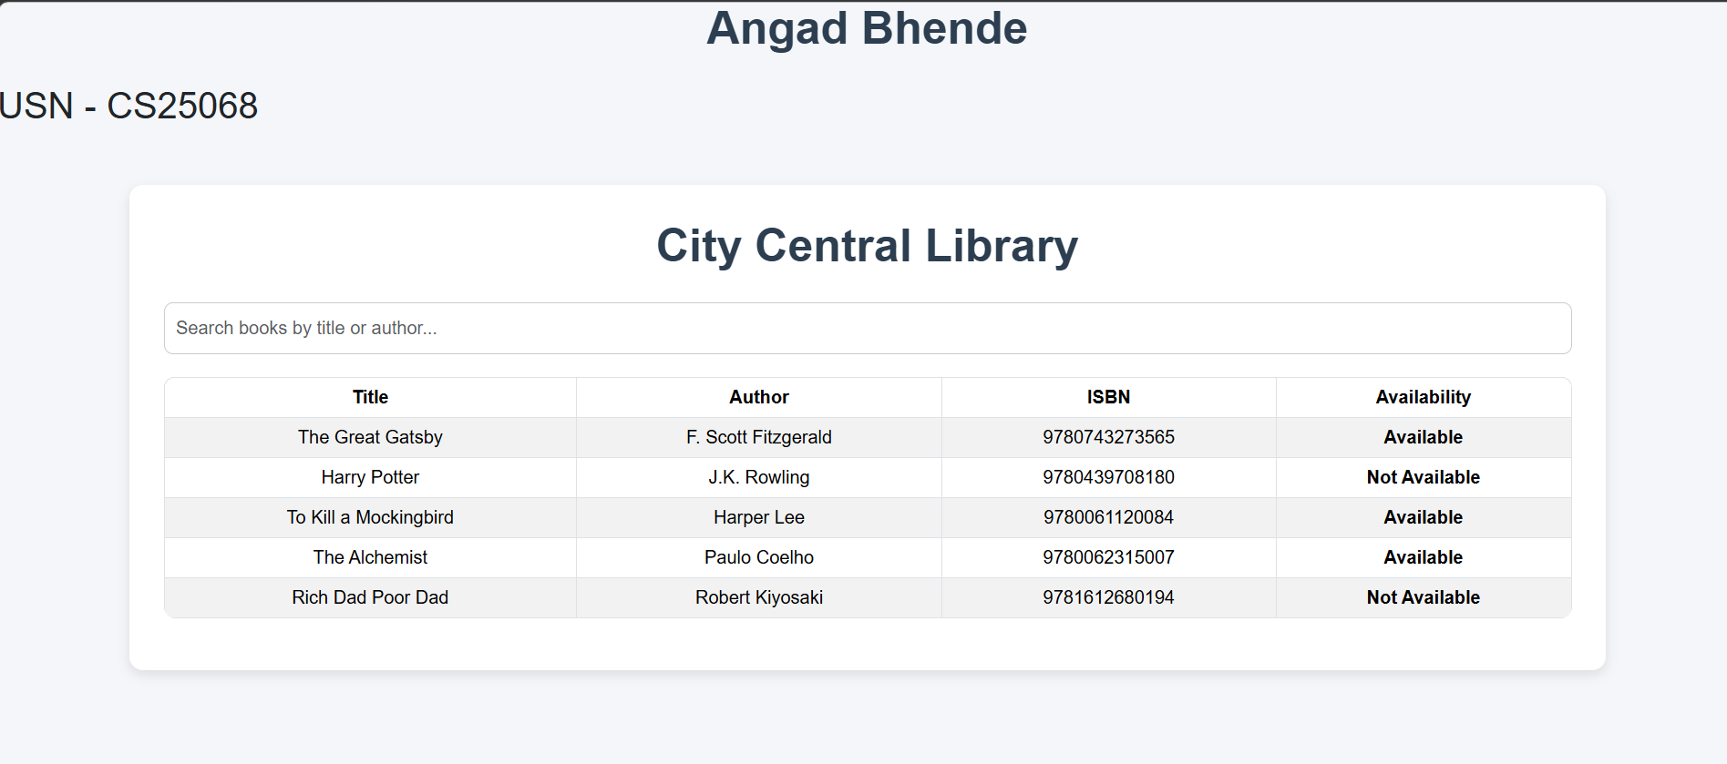
Output Screenshot:-

Slide 5
Tags used for Css :-
1. background-color
Used to set the background color of an element.
Makes the webpage attractive and readable.
background-color: #f4f6f9;
2. font-family
Changes the style of text/font.
Improves readability and design appearance.
font-family: Arial, sans-serif;

Slide 6
3. margin-top
Adds space outside the element from the top side.
Used for proper spacing between sections.
margin-top: 50px;
4. padding
Adds inner spacing inside an element.
Makes content look clean and properly aligned.
padding: 30px;

Slide 7
5. border-radius
Rounds the corners of boxes, tables, or buttons.
Gives a modern UI design.
border-radius: 12px;
6. box-shadow
Adds shadow effect around elements.
Creates depth and attractive card-style layout.
box-shadow: 0 4px 10px rgba(0,0,0,0.1);
7. text-align
Aligns text left, right, or center.
Used for better content presentation.
text-align: center;

Slide 8
8. color
Changes text color.
Used for highlighting important text.
color: green;
9. font-weight
Makes text bold or lighter.
Used to emphasize headings or status.
font-weight: bold;
10. border
Adds border around elements like tables and input boxes.
Improves structure visibility.
border: 1px solid #ccc;

Slide 9
11. overflow
Controls content overflow behavior.
Helps manage large content inside containers.
overflow: hidden;
12. transition
Adds smooth animation effects.
Used in hover effects for better user experience.
transition: 0.3s;
13. hover
Applies style when mouse pointer moves over an element.
Makes UI interactive.
tbody tr:hover { background-color: #f1f1f1; }

Slide 10
Conclusion:
CSS properties are used to improve webpage design, layout, spacing, colors, responsiveness, and user interaction. They help create an attractive and user-friendly Library Book Catalog interface.

